Slide 1

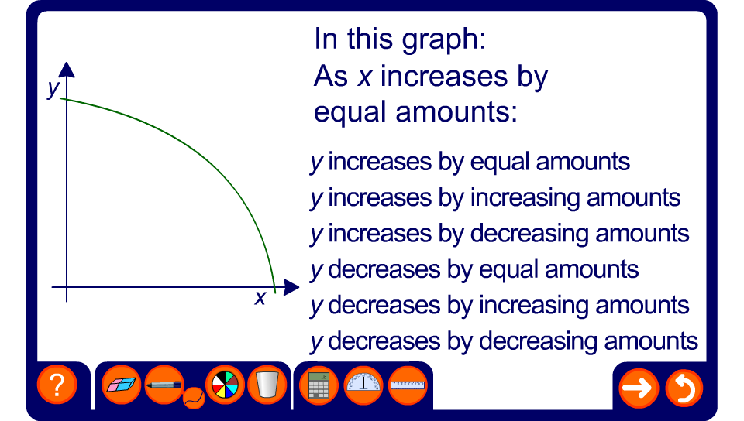


Rates of change
Notes:
For each graph ask pupils whether y is large, small or becomes zero when x is large. Also ask whether y is large, small or becomes zero when x is small.
Establish whether y increases as x increases or whether y decreases as x increases. Then decide whether it is increasing or decreasing by equal, increasing or decreasing amounts.
Ask pupils to describe a real-life situation that could be described by each graph. For example, a graph that shows y increasing by increasing amounts could by showing accelerating if x is time and y is distance.

